Slide 1


Slide 2

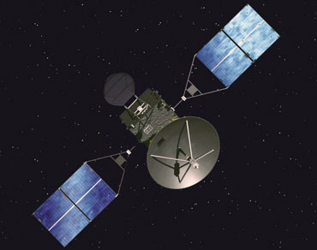
THAPAR UNIVERSITY
STUDENT SATELLITE
Initiative

Slide 3
Thapar University, Patiala
Thapar University is located in 250 acre campus known as Thapar Technology Campus.
It came into existence in 1956. It is strongly backed and supported by Avantha Group formerly known as Thapar Group.
First president of India Dr. Rajendra Prasad laid the foundation stone and since then Thapar University is providing quality technical education.

Slide 4
Various Other Projects
Formulae SAE : Team Fateh
DRDO UAV Challenge : UAV Team
Thapar University Student Hybrid Car
Naval Vessel Project
many more ……..

Slide 5
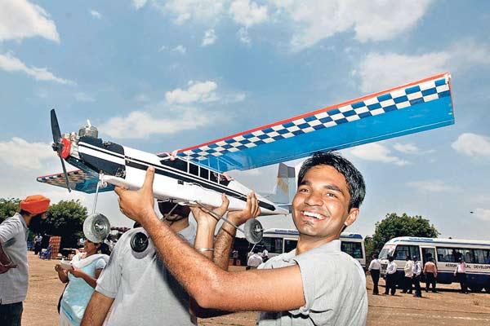
Appreciation
We bagged 1st price in a UAV building competition organised by DRDO.
Second place was bagged by IIT Madras and third by MIT, Chennai.

Slide 6
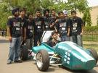
Appreciation
Our Univeristy team ( Team Fateh ) got 67th position in Formula SAE, UK and was the only Indian Team to clear the Endurance Round.
IIT Bombay bagged 51st position in Formula SAE, UK

Slide 7
TUSSAT Initiative Objective
Like other student satellite project, our main driver is to actually gain experience which we could got get by just reading books and listening to lectures. The bottom line is dealing with all aspects of space mission by conceptualising, designing and developing virtually all subsystems.
Principally we can distinguish our objectives into two cateogories:

Slide 8
Educational Objective:
Collaboration and contacts with industry universities and other student satellite project groups.
Insight into system engineering process and team dynamics.
Deeper understanding of subjects.
Scientific and Research Objective for TUSSAT – I:
Will be explained during payload.

Slide 9
Full Mission | A full mission comprises a reduced mission plus: A reliable communication and data transfer between spacecraft and ground station. All subsystems fully operational as described later on.
Reduced Mission | The reduced mission would be minimum plus: The reception of signals from the satellite.
Minimum Mission | The minimum would be: The complete development of spacecraft and ground segment. The launch of the satellite.

Slide 10
Mission TUSSAT-I
Mission Objective
Payload
Technical Details
Time Line
Initial Sub-System Identified
Supporting Institution
Team Details

Slide 11

Exterior Dimensions: 270mm*270mm*270mm
Maximum Mass: 10 kg
Internal temperature: -40°C to 70°C Degree Celsius for best performance of components
We will be using COTS Industrial Grade Components.

Slide 12
Functional Aspects
Cost | Way beyond what we have right now. However, we are in touch with very few number Sponsoring Agencies.
Schedule | To be Launched in the Late 2011
Regulations | All safety and environments norms will be followed with letter and spirit.
Environment | The Satellite will be exposed to LEO Space Conditions
Communication Links | Downlink Uplink ( Currently doing feasibility studies)
Development Constraints | No Aerospace Department in Thapar University, Patiala. Academics ☺

Slide 13
Operational Requirements
Duration | 6 to 8 Months - Due to observation the flux change of Green House Gas Density
Availability | 5 to 8 Minute during 1 pass 1-2 Clear Passes per day
Survivability | To secure its operation time, Spacecraft and it components have to withstand the environmental condition.
Data Distribution | Direct Data Distribution is proposed. However, FIPMS has some reservation which are being addressed.
Data Content, form and format | We proposed free distribution without any encryption.

Slide 14
Various Supporting Institutions
IIT Bombay : Thanks Mr. Saptarshi Ban
ISRO
TERI
Government of Germany.
Fraunhofer Institute for Photonic Microsystems, Germany

Slide 15

Payload
Attitude Determination and Control System
Communication System & Ground Station
On Board Computers
Power System
Structure & Thermal System

Slide 16
Timeline

Slide 17
4
Phase A
3
Phase B
2
Phase C
Phase D
1
Launch
0

Slide 18
Phase A
Basic Understanding & Conceptual Design
May ‘09 to September ‘09

Slide 19
Phase A - Objectives
Feasibility Study
Design Trade Offs
Preliminary Design
Signing of Agreements for Infrastructure Support and Technical Assistance
IITB Commitment for TEC Ground Station

Slide 20
Phase B
Detail Design
Oct 2009 to January 2010

Slide 21
Phase B - Objectives
Design Refinement
Component Tests
System and Subsystem level specifications

Slide 22
Phase C
Detailed Design Review
Feb 2010 to July 2010

Slide 23
Phase C - Objectives
Detailed definition.
Breadboard tests .
Final Specifications.

Slide 24
Phase D
August 2010 to December 2010

Slide 25
Phase D - Objectives
Integration Model
Flight Model
Flight Production
Subsystem and system tests

Slide 26
Team
This is entirely a student initiative.
Kavya Garg
Project Manager
(kavya@tussat.in)
Sohil Batra
Project Manager
(Sohil@tussat.in)

Slide 27
Subsystem
Communication : Kirti and Sourav ( 4 more )
ADCS : Deepika and Astha ( 4 more )
Power : Nitika and Abhay ( 3 more )
OBC : Lokesh and Shobit ( 3 more )
Structure : Gurjyot

